Slide 1



Fixing traffic in Zürich A data-driven control approach
Alessio Rimoldi
Prof. J. Lygeros, Prof. F. Dörfler

Slide 2
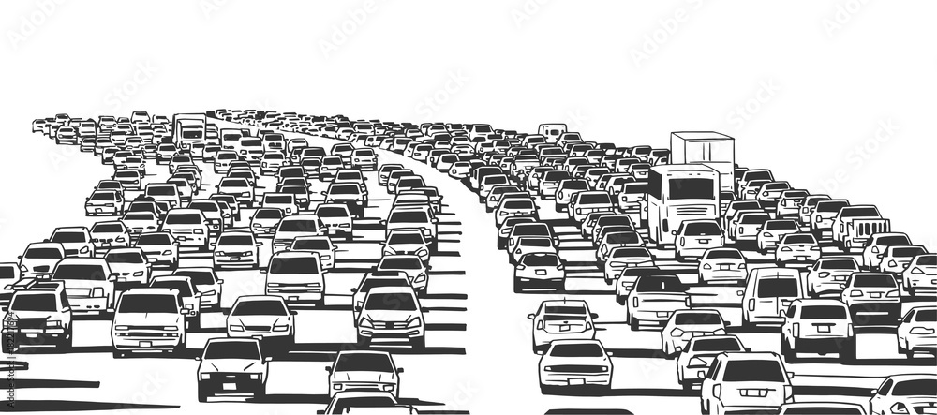
Traffic is a huge problem
$1.2T
US investments
54h
wasted
wasted
12%
CO2 emission

Slide 3

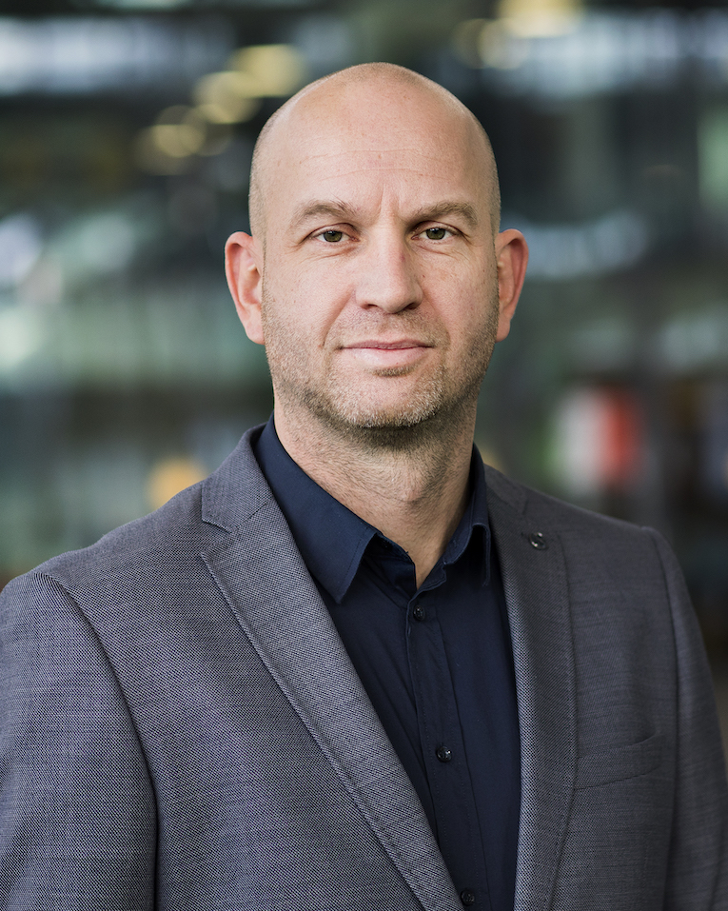
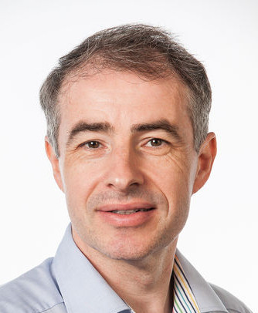

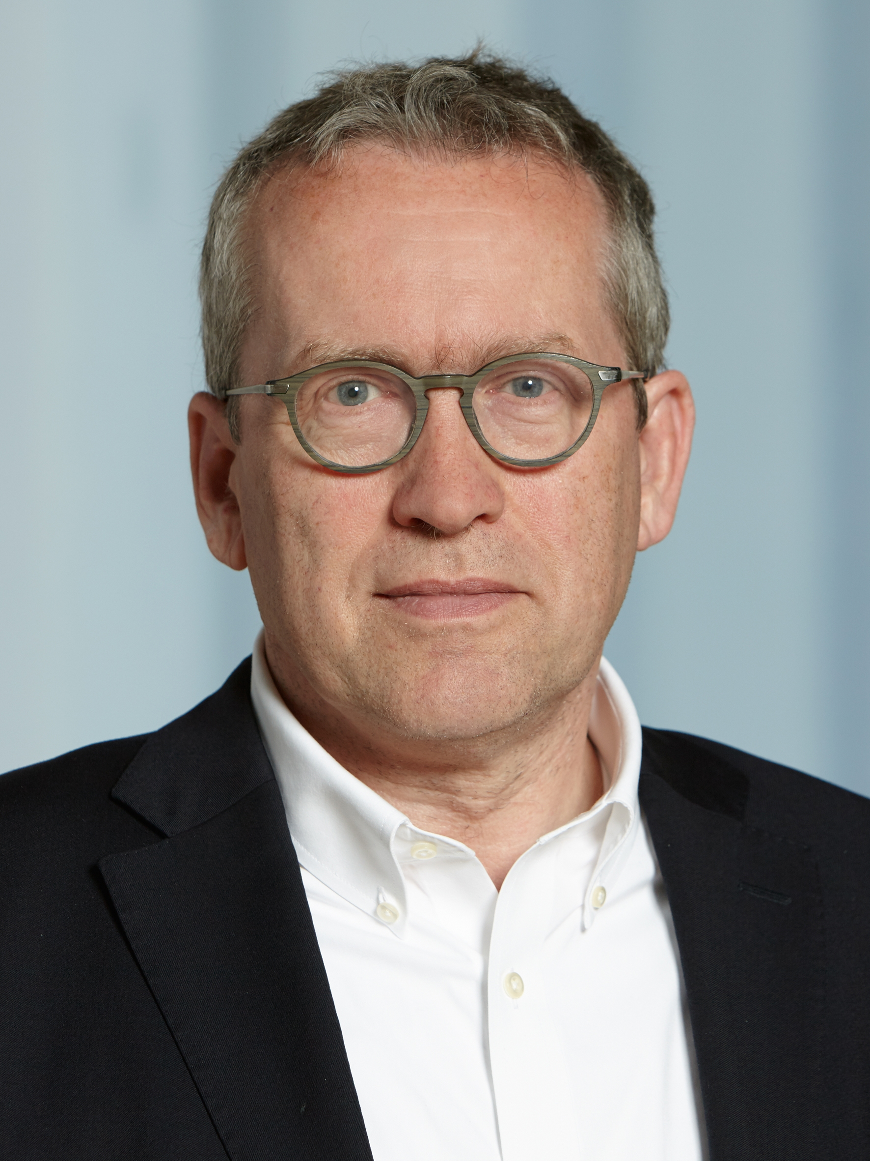

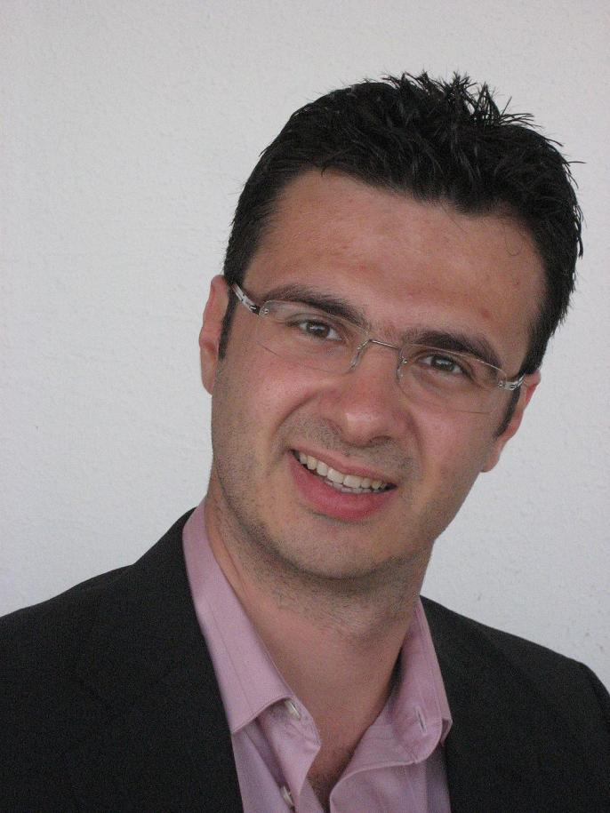

Urban Traffic Control
Academia
Companies
Model Based
Expensive model estimation
Expert knowledge is often needed
Maurice Hemmels
ATVs
AUDI
Audi connect
Bart De Schutter
Traffic light Control
TNO
Automated transport
Kay Axhausen
Demand estimation
Continental
IoT traffic
Machine Learning
Interpretability
Modularity
Scalability
Nikolas Geroliminis
Perimeter control & MFD
…and many others
Transcality
Digital twins &
simulations

Slide 4
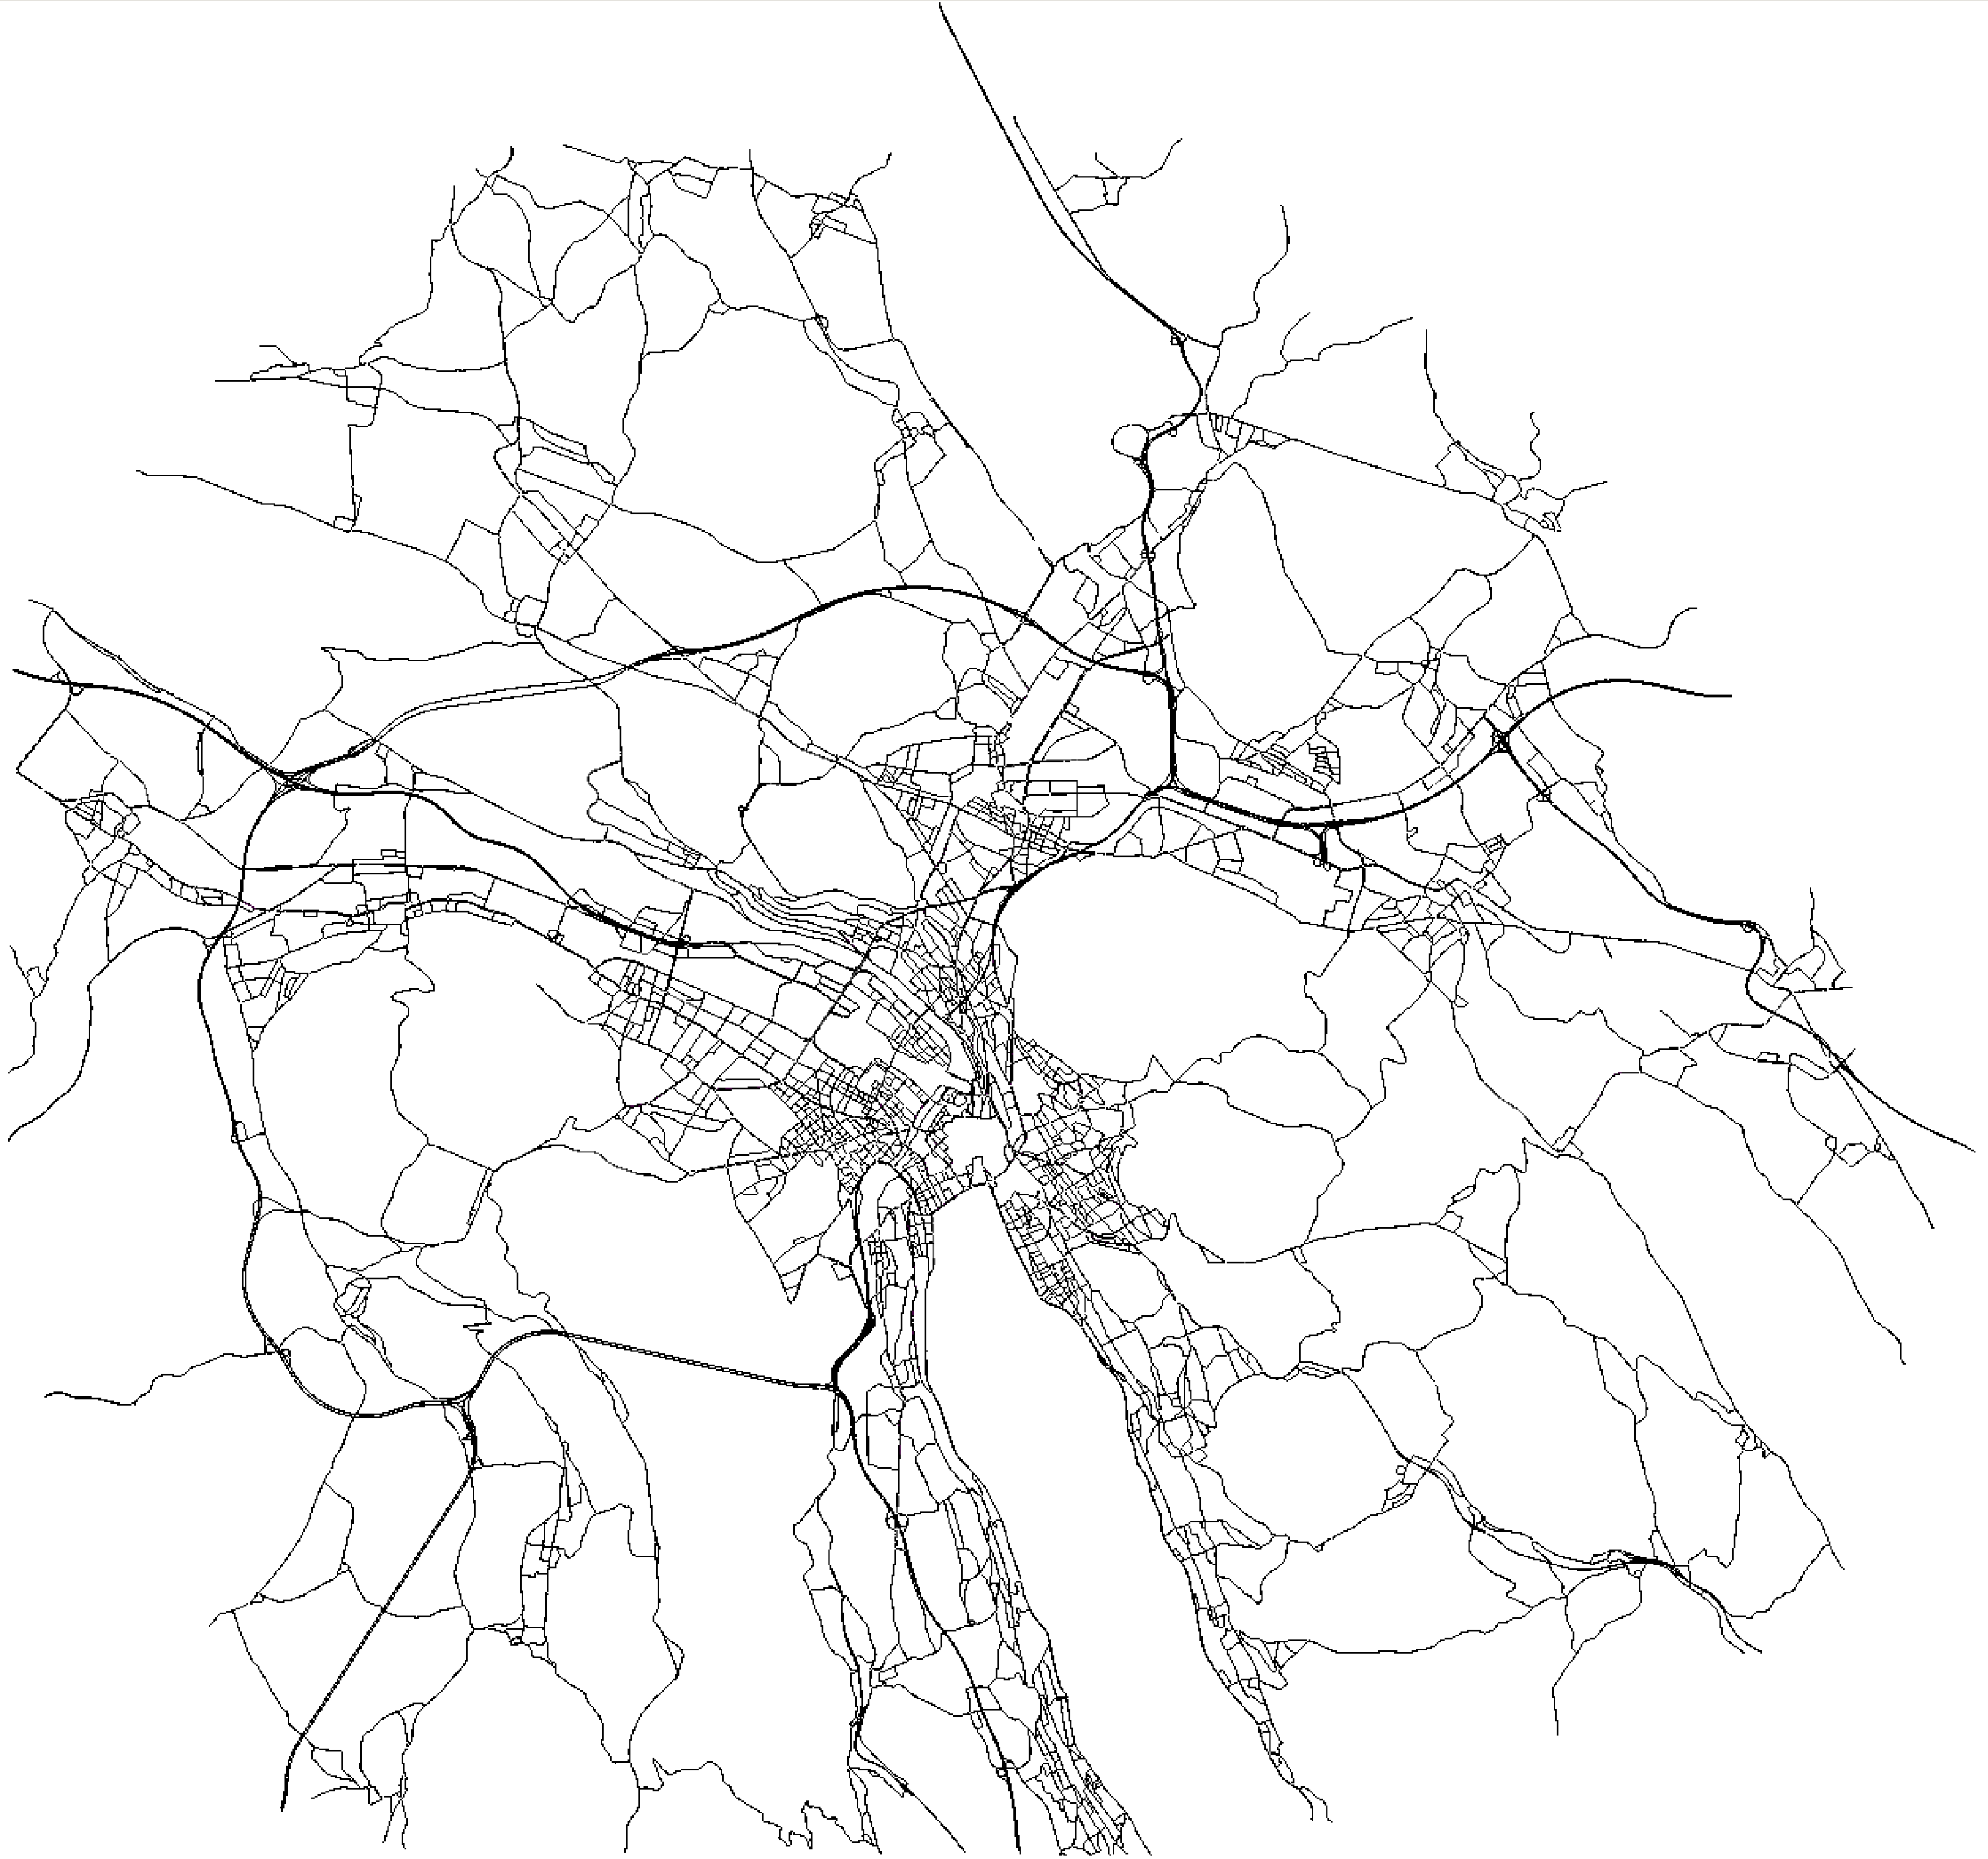



Take-home message
- realistic microsim.
Use high-fidelty sumulations
Create a modular interface
SUMO - Python
Use DeePC to perform urban traffic control
A first step towards a unified framework for testing and benchmarking algorithms.
Repo
Repo
DeePC

Slide 5
The menu
Problem formulation
Framework
Results

Slide 6
The menu
Problem formulation

Slide 7
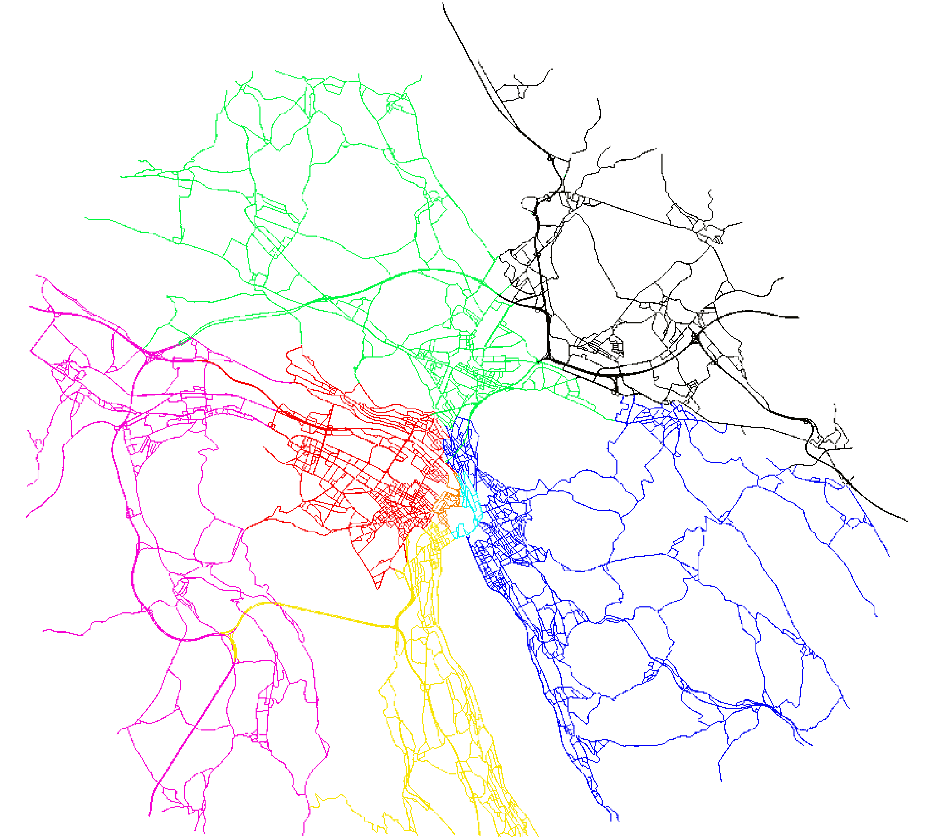


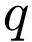

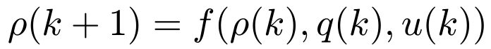
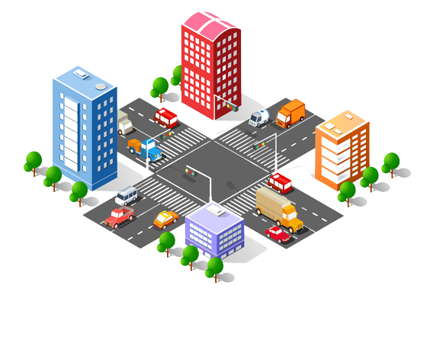
Problem formulation
Density : veh / km
Flow : veh / min
Demand : veh / min
Input : green time / period

Slide 8
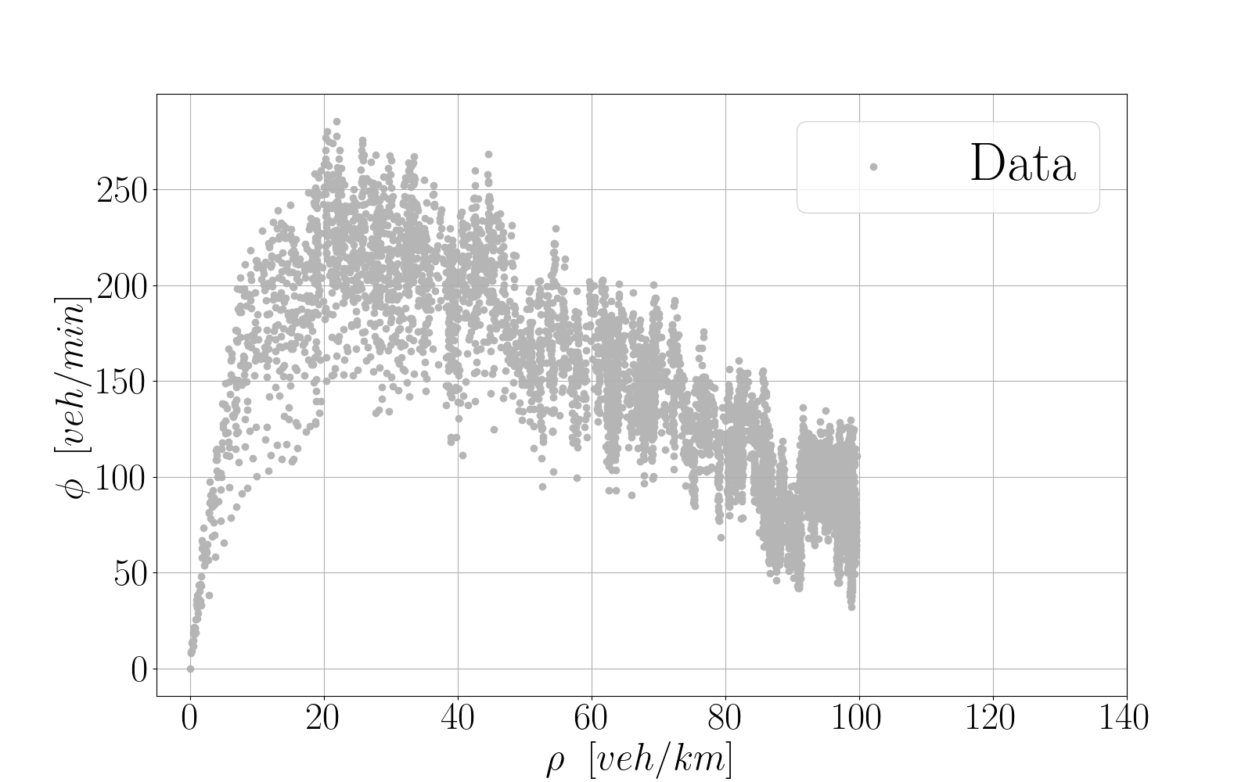
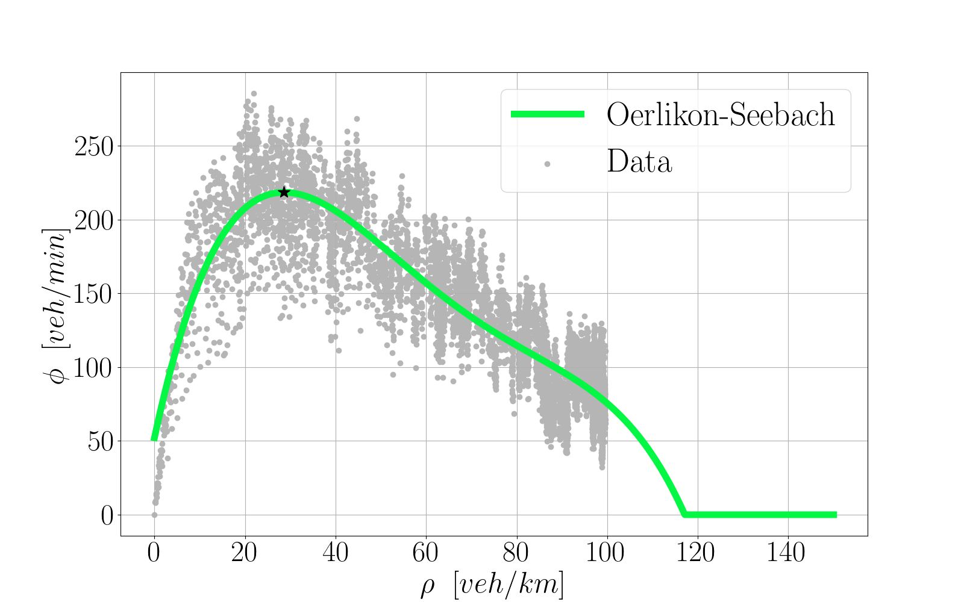
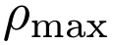
Problem formulation
Density : veh / km
Flow : veh / min
Demand : veh / min
Input : green time / period

Slide 9
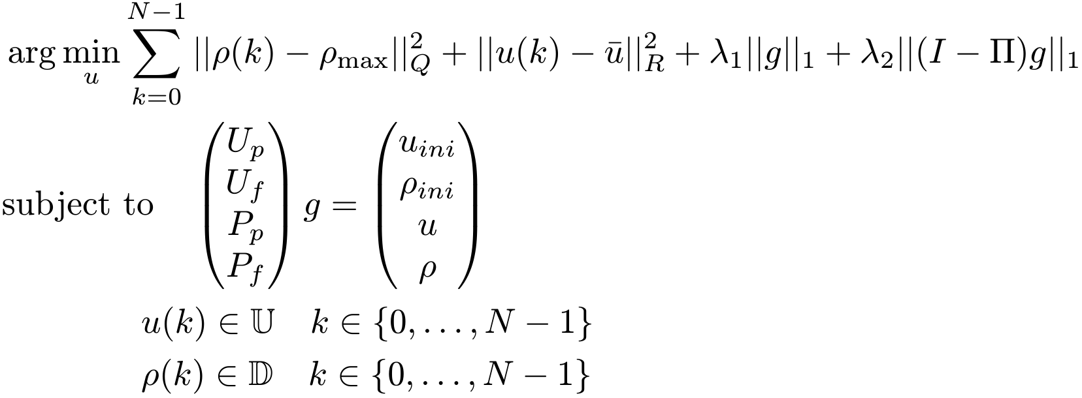
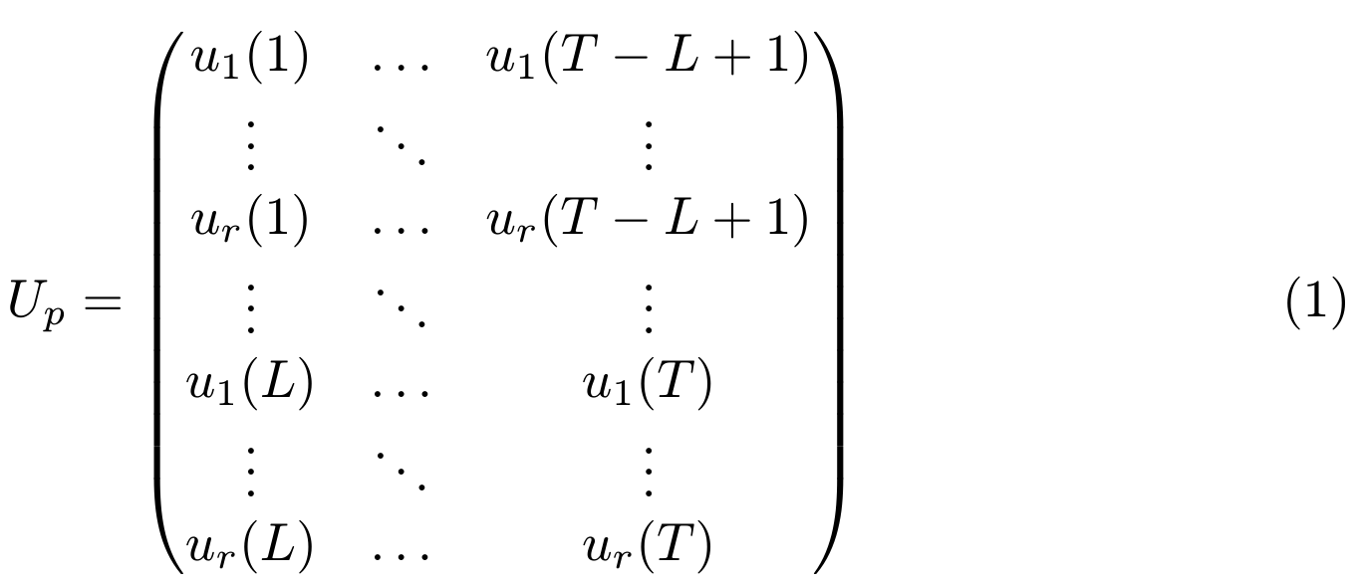
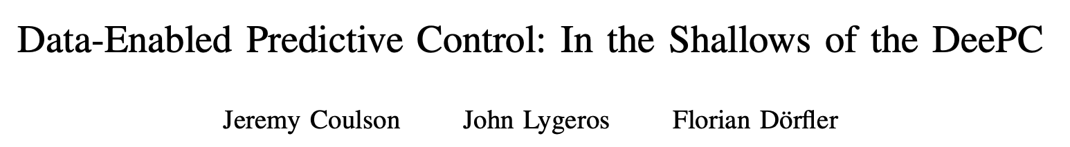
DeePC

Slide 10
The menu
Framework

Slide 11
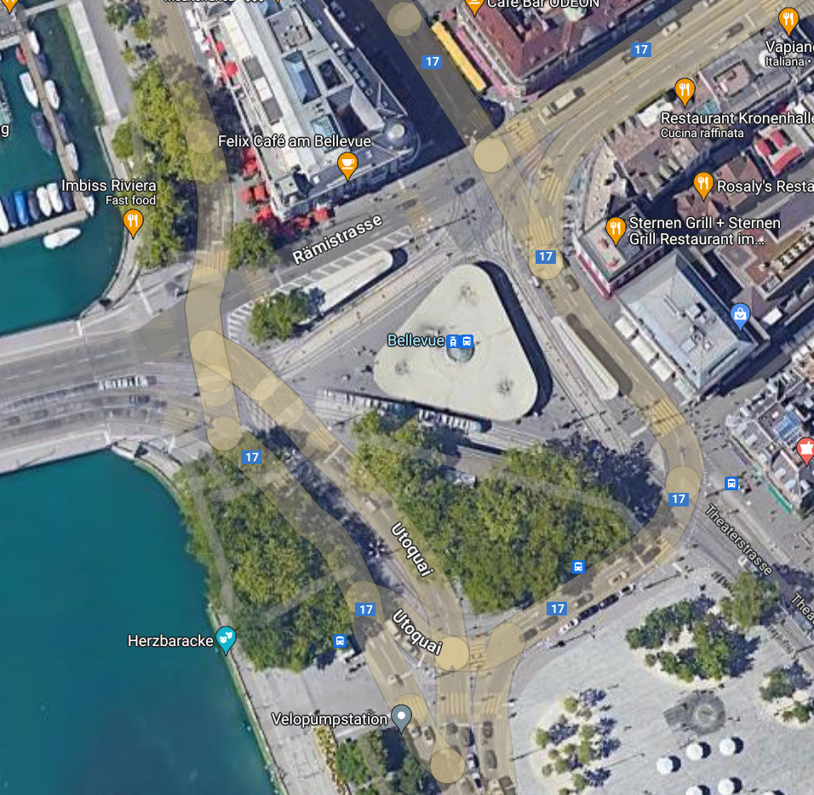
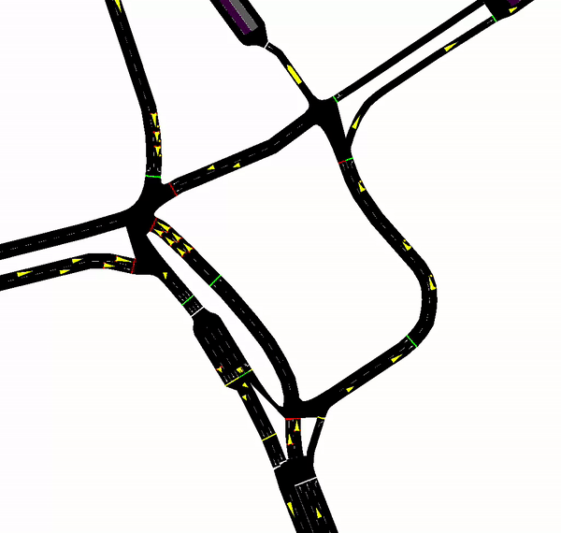
Simulation framework
14566 roads
6917 intersections
800 traffic lights
Vehicles: cars,vans,trucks,buses...

Slide 12
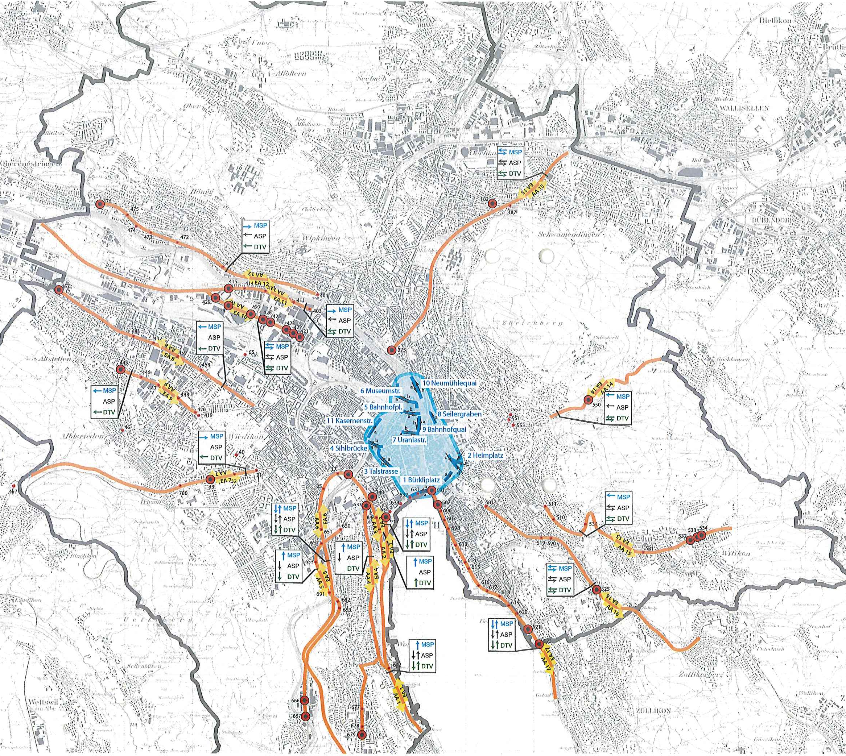

Actuator selection
47 actuators used in the real case
Positioned on high volume traffic flows
Designed to protect the center from congestion

Slide 13

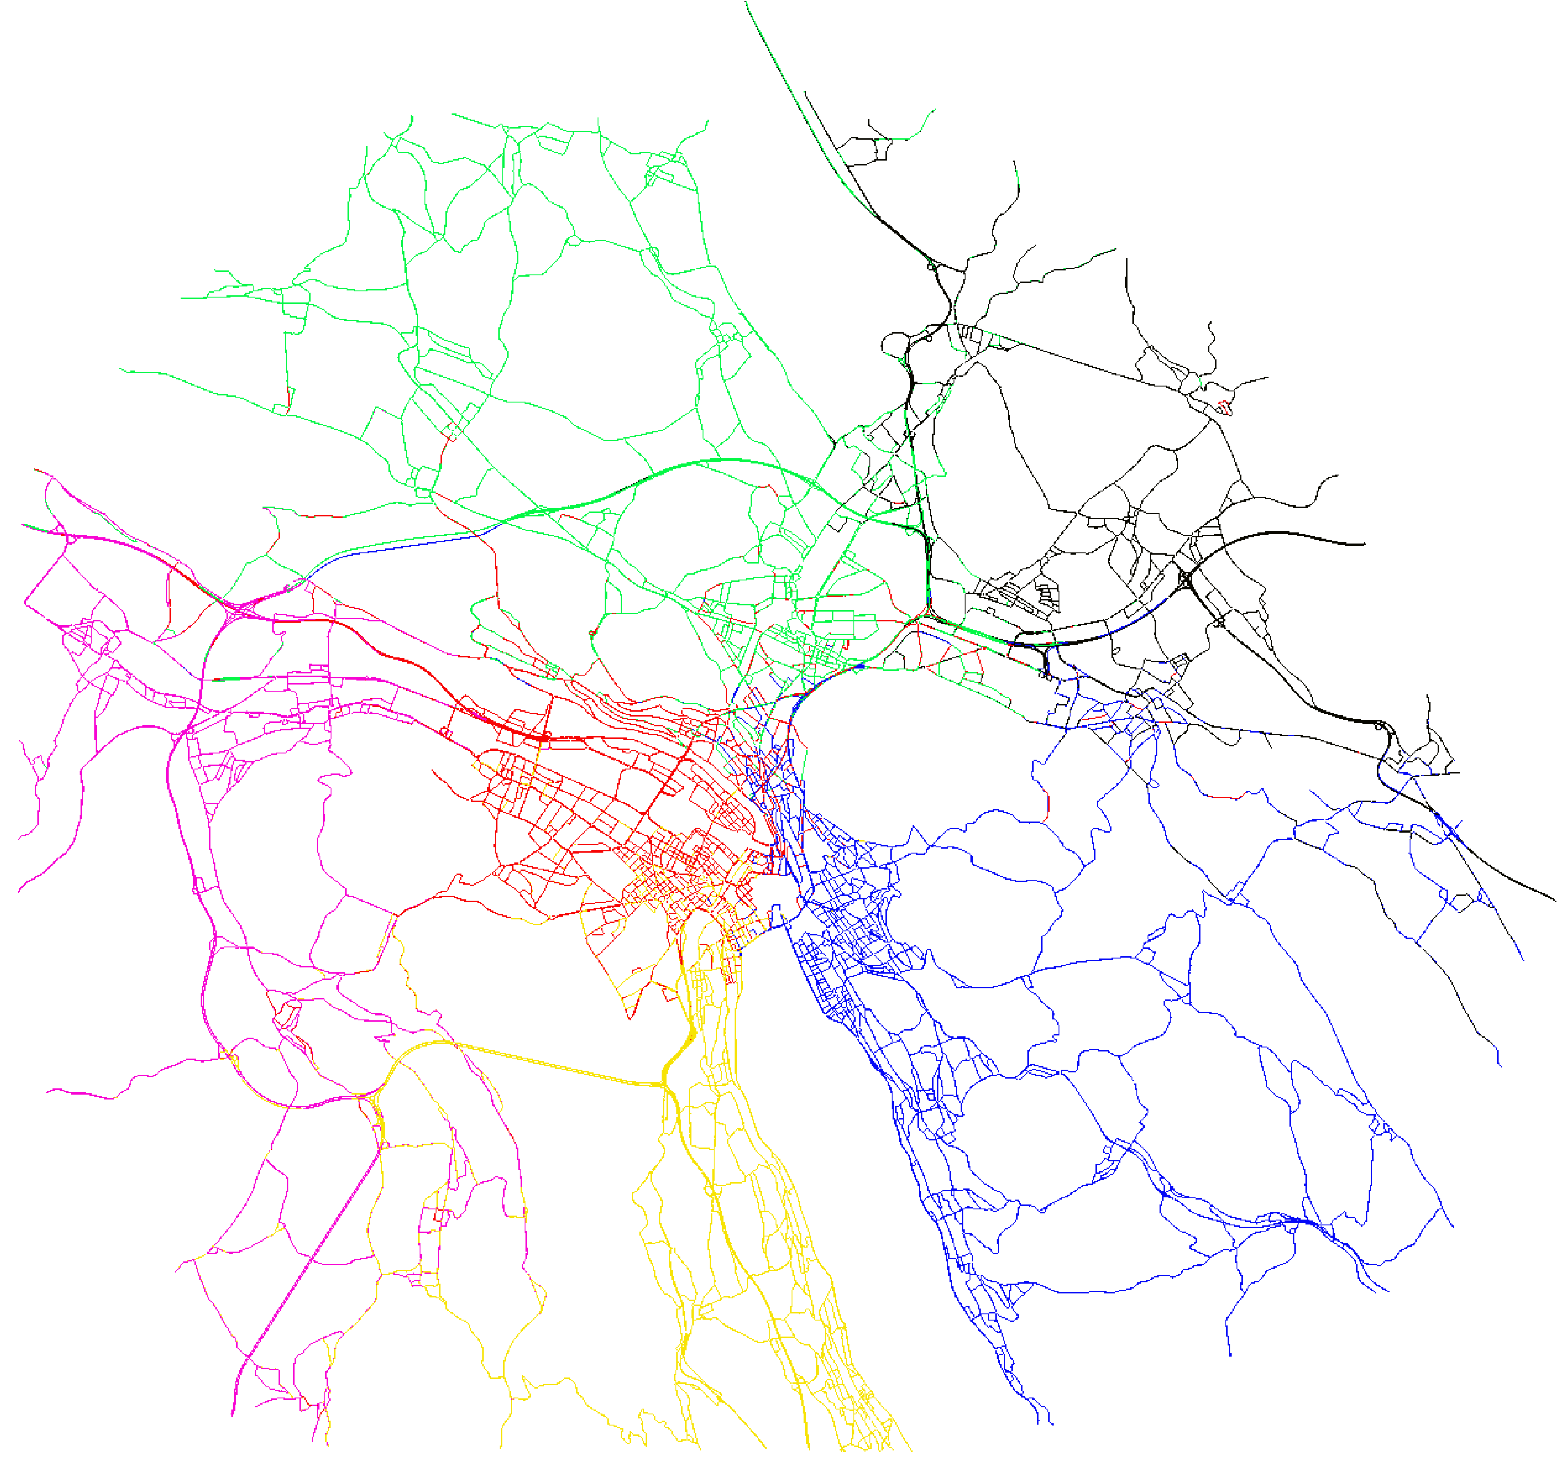
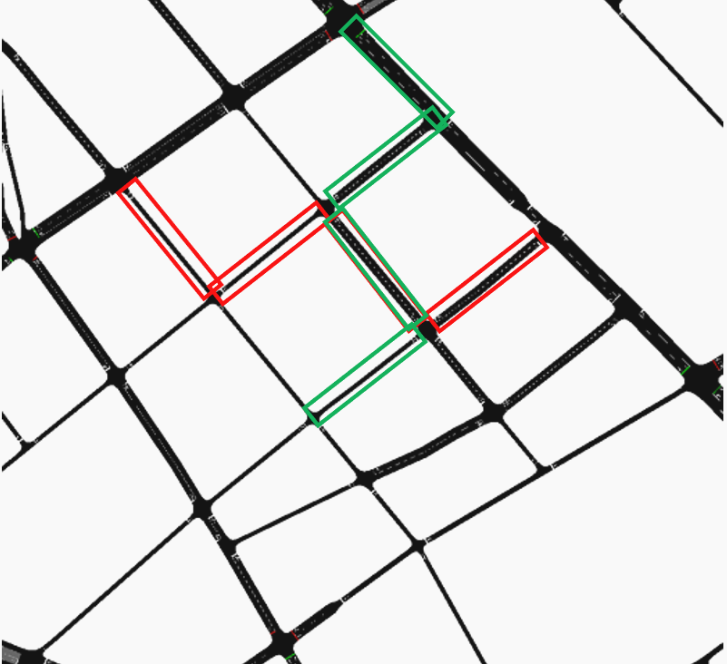
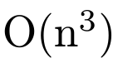
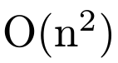
Clustering
We devised a Post-Processing procedure

Slide 14
The menu
Results

Slide 15
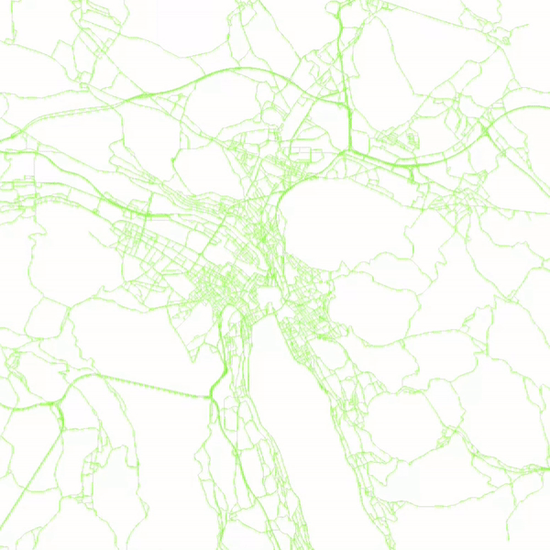
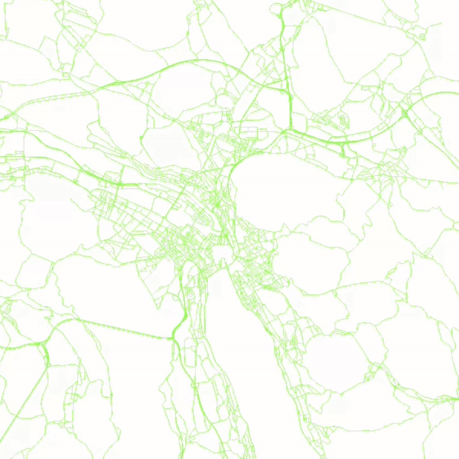
Case studies : congested vs uncongested
low congestion
high congestion
Congested case
Uncongested case
16.00 - 21.00
16.00 - 21.00

Slide 16
Case studies : uncongested
low congestion
high congestion
Uncongested case
Controller | NoControl | MPC | DeePC
Travel Time (min.) | 29.1 | 28.1 | 26.5
Waiting Time (min.) | 16,1 | 15.3 | 13.9
CO2 Emissions (kg) | 4.745 | 4.599 | 4.348
Totals | MPC | DeePC
Hours | 2,095 (4,6 %) | 5,886 (13,0%)
CO2 (kg) | 23,448 (2,9%) | 65,722 (8,2%)
16.00 - 21.00

Slide 17
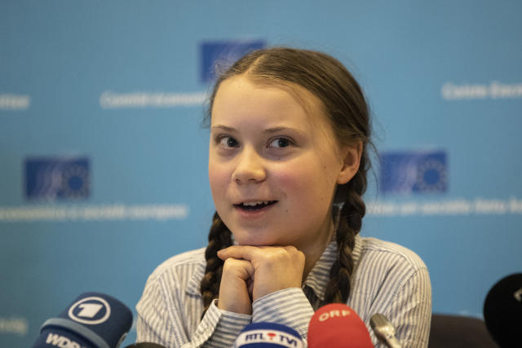
Case studies : congested
low congestion
high congestion
Congested case
Controller | NoControl | MPC | DeePC
Travel Time (min.) | 86.8 | 85.1 | 84.0
Waiting Time (min.) | 60.7 | 59.7 | 59.2
CO2 Emissions (kg) | 13.680 | 13.414 | 13.239
Totals | MPC | DeePC
Hours | 2,781 (1,3 %) | 6,286 (3,1%)
CO2 (kg) | 48,654 (1,7%) | 83,406 (2,9%)
16.00 - 21.00

Slide 18
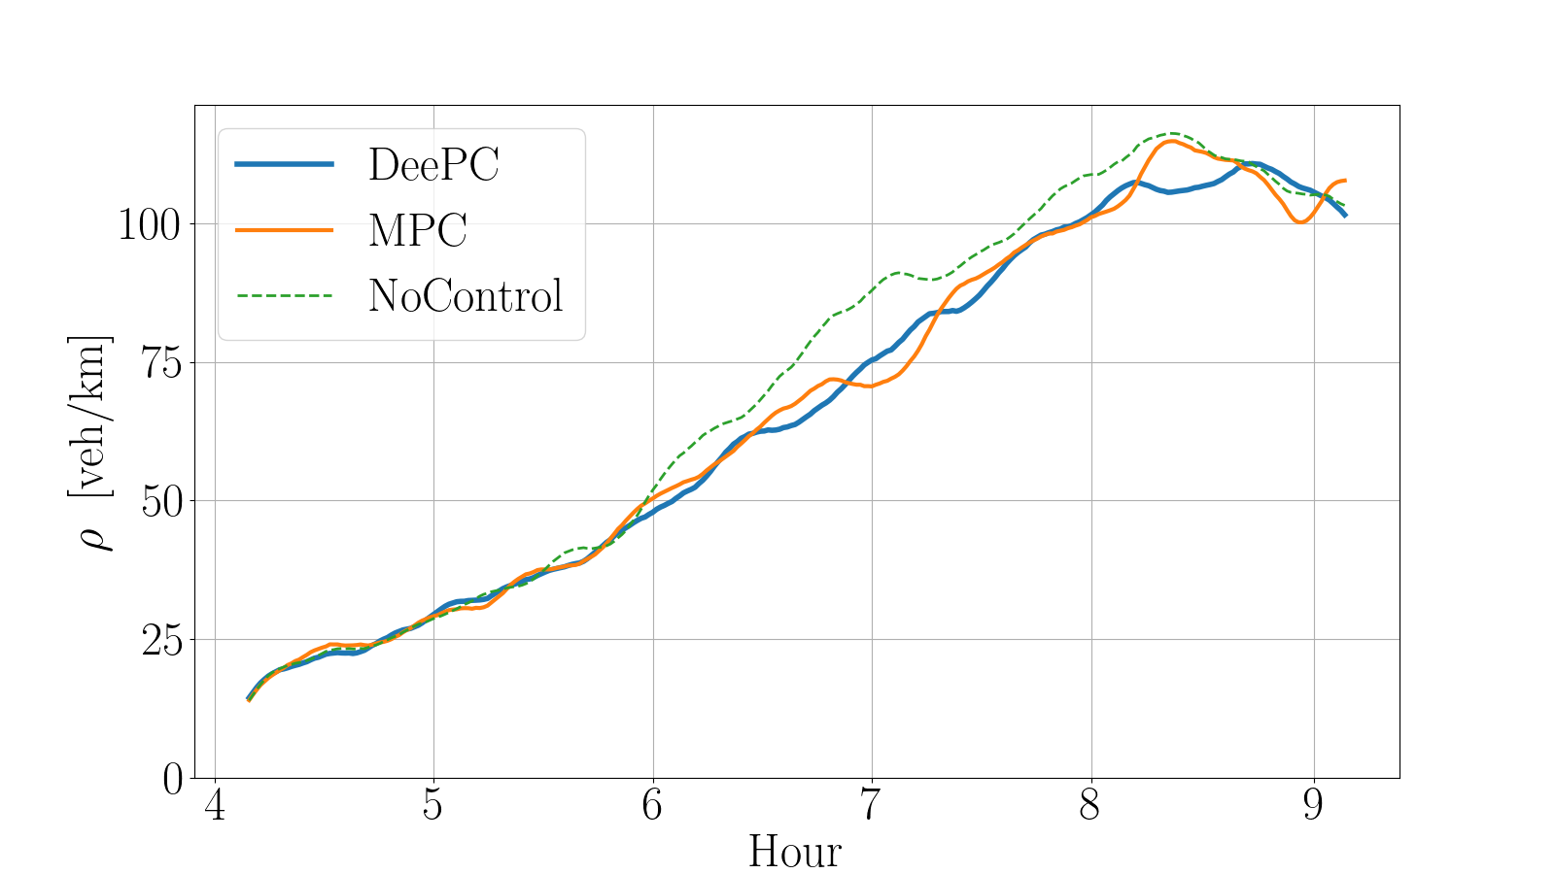
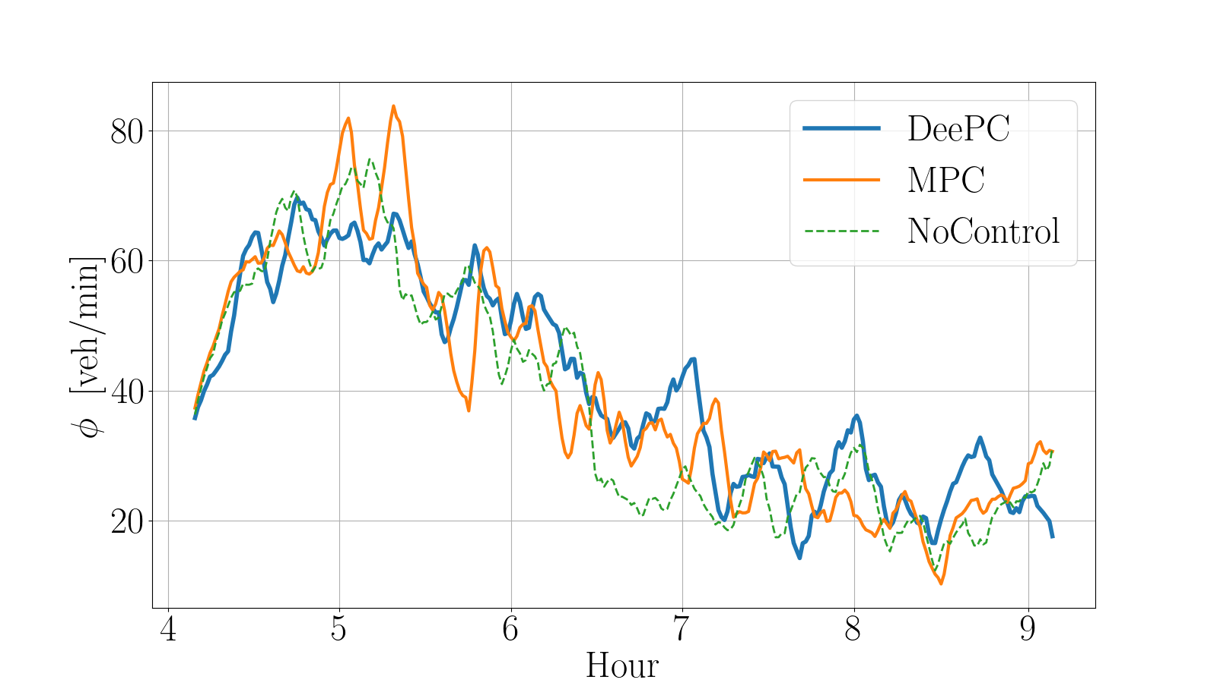
What's happening under control?

Slide 19


Conclusion
- realistic microsim.
Summary
data-driven predictive control for traffic congestion
Outperformed model based method
uncongested: 300% on travel time and CO2
congested : 250% on travel time and CO2
Future research directions
Expand control_sumo repository
Develop benchmarks and automated testing
Address scalability and PE issues
Sim-to-real experiments
Repo
Repo
Thank you!
Questions?
DeePC
Alessio Rimoldi
alessio.rimoldi.work@gmail.com

Slide 20
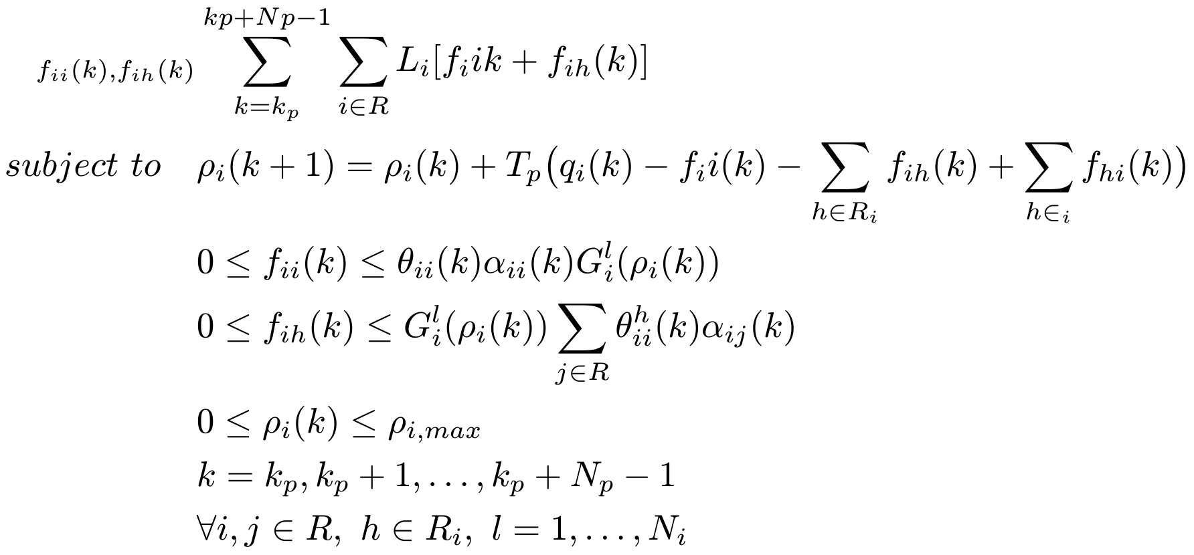
Additional Slides : Linear Model Predictive Control Formulation

Slide 21
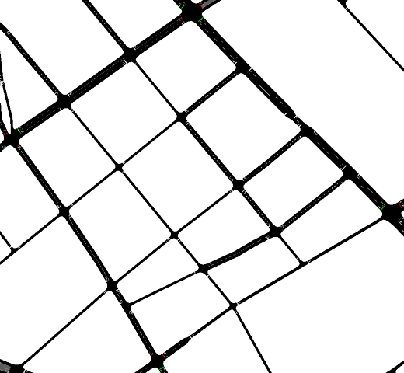
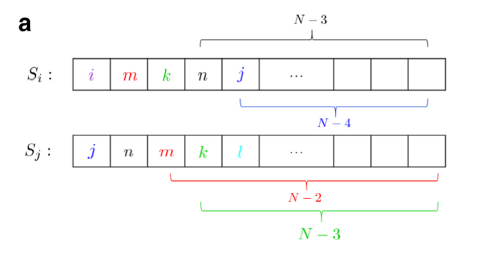
Additional Slides : Snake Clustering

Slide 22
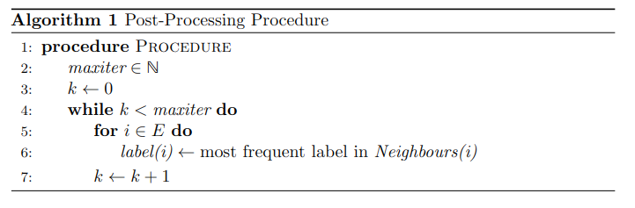
Additional Slides : The post -processing procedure

